Slide 1
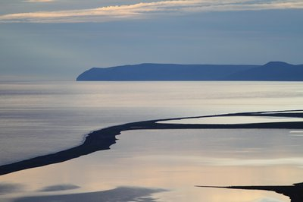
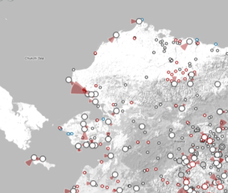
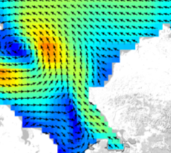
STAMP Overview
Spatial Tools for Arctic Mapping & Planning
April 6, 2012

Slide 2
Background
NOAA funding – Regional Ocean Partnership Program
$760K over 1.5 year project
Project partners:
AOOS/Axiom
UAF’s Alaska Center for Climate Assessment & Policy
UAA’s Institute for Social & Economic Research
The Nature Conservancy

Slide 3
Goals
Identifying specific data & info needed for future decision-making related to Arctic commercial fisheries
New data & information tools that improve the access and usability of Arctic data.

Slide 4
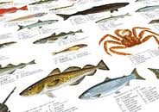
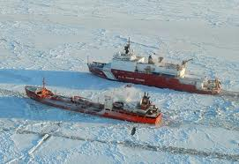
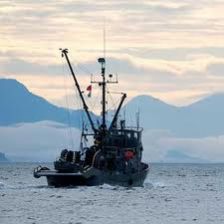
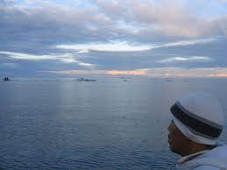
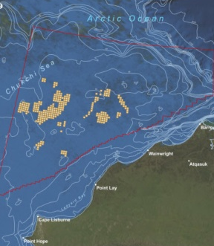
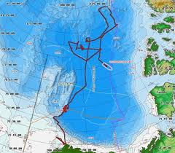
Goals
Identifying specific data & info needed for future decision-making related to Arctic commercial fisheries
New data & information tools that improve the access and usability of Arctic data.
Focus on fisheries, but applications intended to be broad

Slide 5
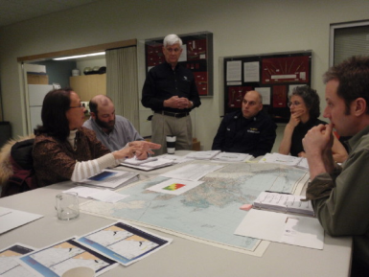
Who are the tools designed for?
Resource managers and planners
(tribal, local, state, federal, industry, NGO)
Stakeholders who provide input into those decisions
People with interest in specific aspects of the Alaska marine environment, and who want to access data

Slide 6
Intended Capacity of the Tools
Provide accessible, relevant information for decision-making
Intuitive interfaces
Store, use and provide access to more complex types of information
Enable users themselves to perform useful spatial analysis routines and data analysis.

Slide 7
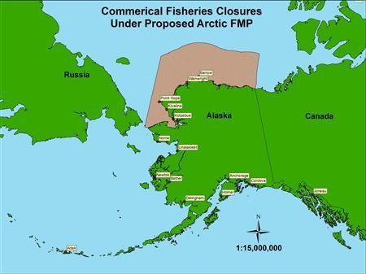
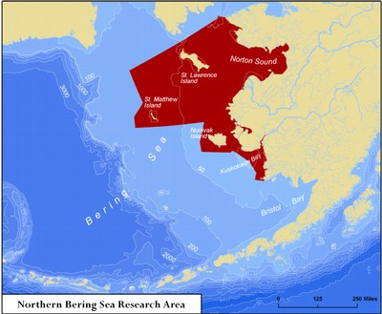
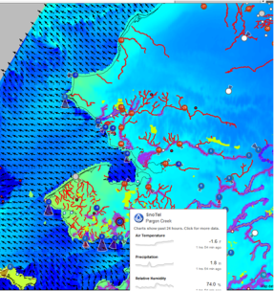
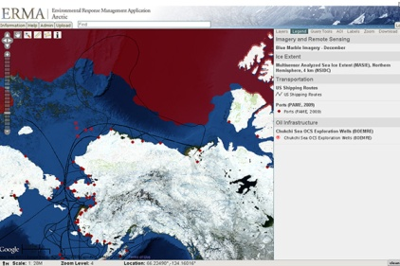
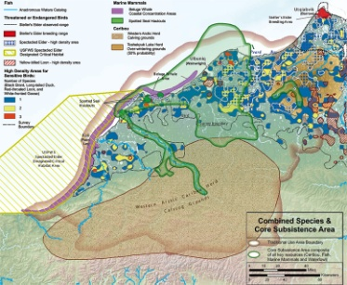
Building off Existing Work
2009 Arctic Fisheries Management Plan
Northern Bering Sea Research Study Area
Leveraging data collection efforts:
AOOS Ocean Portal
Deep-draft Arctic port study (DOT, USACE)
USCG’s Bering Strait Port Access Route Study
Arctic ERMA
Subsistence mapping projects
Others…

Slide 8
Project Component 1: Scoping
Guidance of Project Advisory Group & other informants
Assessment of other planning initiatives
Review of existing decision support tools
Interviews with decision makers
Meeting in Northwest Alaska in the fall

Slide 9
Project Component 2:
Obtain & synthesize prioritized data layers, and incorporate them into AOOS Arctic Portal
Data
Socio-economic, human use, community profile info (ISER)
Climate projections for sea ice/ocean conditions (ACCAP)
Existing physical, chemical, biological datasets
Maybe additional data collected at recommendation by advisory group?
*

Slide 10
Project Component 2:
Obtain & synthesize prioritized data layers, and incorporate them into AOOS Arctic Portal
Data
Socio-economic, human use, community profile info (ISER)
Climate projections for sea ice/ocean conditions (ACCAP)
Existing physical, chemical, biological datasets
Maybe additional data collected at recommendation by advisory group?
*Then shape the tools to do the cool things people asked for*

Slide 11
Project Component 3: Review
Do the tools meet the intended needs?
Review by project advisory group
Workshop for Project Advisory Group and other representative decision-makers and stakeholders
Demo the tools – view and test!
Get additional feedback on the tools for next version

Slide 12
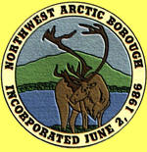
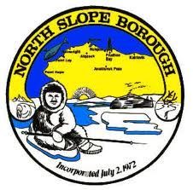
Project Advisory Committee
Representing those who would actually use decision support tools in their work, including industry
Role
Help shape tool functionality
Identify desired & available data
Beta test new tools
Help link other individuals who could benefit from or provide guidance to the project

Slide 13
Contributors (a sampling)
Alaska Native Tribal Health Consortium
Alaska Sea Grant Program (NOAA)
CDQ groups
Geospatial Information Network of Alaska
NOAA
North Pacific Fisheries Management Council
North Pacific Research Board
North Slope Borough
North Slope Science Initiative
Northwest Arctic Borough
Seafood Industry/Processors’ Assoc, pollock industry
State of Alaska Agencies (ADF&G, ADNR, ADEC, DOT)
State Seafood Specialist
University of Alaska representatives (School of Fisheries & Ocean Sciences, Department of Political Science)
US Arctic Research Consortium
US Coast Guard
US Fish & Wildlife Service Western and Arctic LCC’s
USGS Alaska Science Center and Regional Climate Science Center
World Wildlife Fund
And others…

Slide 14
Outreach
Project website: http://www.aoos.org/stamp/
List serve for periodic project updates
Meeting in northwest region in fall 2012
Anchorage workshop in 2013
Demo at AK Forum for the Environment 2013
Soliciting input through advisory committee contacts and additional informants
Other (we want your ideas)

Slide 15
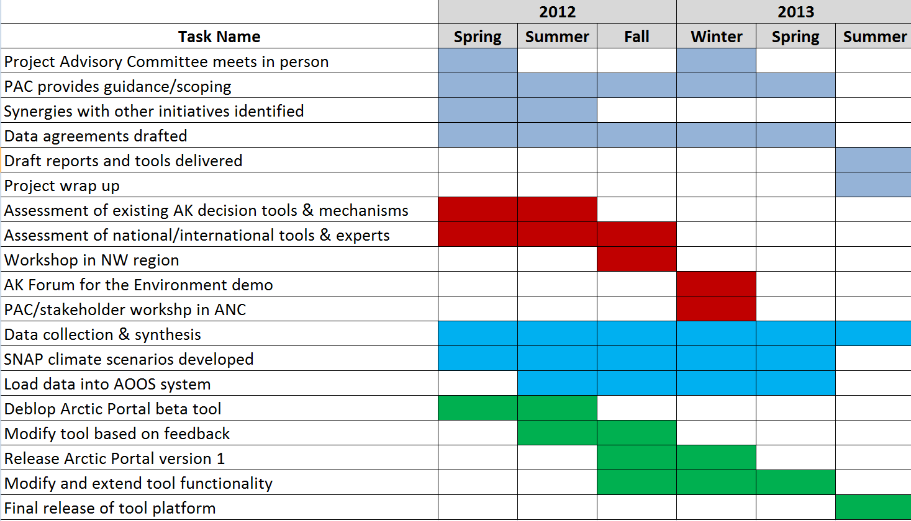
Project Timeline

