Slide 1
STAMP: Data and Tool Development
Spatial Tools for Arctic Mapping & Planning
April 6, 2012

Slide 2
Summary
Progress to date and focus thus far
Coordination and leveraging of existing efforts
Data ingestion to date and future directions
Demo of current Ocean Portal: Arctic Portal
Adaption of approach based upon scoping document and lessons learned
Brief demo of Research Workspace
Notes:
Split among 5 entities
Started in Jan, so finish in July 2013
Will be talking about the role of each of these groups, and they will all be speaking about their specific components this morning

Slide 3
Progress to Date
Tool Development
Polar projection – All data types (Features, Grids, and Vectors)
Refine user interface
Isolate existing data layers in AOOS to expose through the tool (391 layers )
Establish relationships and coordinate with parallel efforts
Ingest data. Focus on types specific to AOOS capabilities.
Notes:
Split among 5 entities
Started in Jan, so finish in July 2013
Will be talking about the role of each of these groups, and they will all be speaking about their specific components this morning

Slide 4
Leveraging of External Efforts
Arctic ERMA
NSIDC – Atlas of the Cryosphere
Arctic Portal – Circumpolar Bio-Diversity Program (CBMP)
Arctic Eis and other BOEM – Franz Mueter, etc…
PacMars – NPRB Funded Numerical Synthesis of Arctic data
Synthesis of Arctic Research (SOAR) – Literature Synthesis
Notes:
STAMP has two main goals.

Slide 5
Data Sets Ingested
NSIDC Sea Ice Concentration - http://bit.ly/Rb0uzg
HF Radar Archive - http://bit.ly/Rb21Fp
NWS Sea Ice Drift Forecast - http://bit.ly/Rb1W4y
JPL 1 KM Sea Surface Temperature - http://bit.ly/Rb2kA5
NCEP Skin Temp - http://bit.ly/OPIhc3
IBCAO Bathymetry - http://bit.ly/Rb17IX
USGS Marine Mammal Boat Surveys (40 Species) http://bit.ly/Rb31JO
NSIDC – Atlas of the Cryosphere (94 Layers)
Arctic Portal (CBMP)– Circumpolar Bio-Diversity Program (16 Layers)
Notes:
STAMP has two main goals.

Slide 6
Data Ingestion Moving Forward
ERMA data layers -https://docs.google.com/a/axiomalaska.com/spreadsheet/ccc?key=0AjzVw3xK0vRHdEJTeXpYTS04dFI0Rm5tdUNoanNiWmc#gid=0
Arctic Portal and NSIDC Cryosphere
Arctic Shorezone (Waiting on Nuka)
Data from project partners (ISER and ACCAP)
Isolate additional habitat, biology, etc….
Notes:
STAMP has two main goals.

Slide 7
Adaption….
Realization: There’s a large amount of data relevant to planning in the Arctic which does not lend itself to be visualized on a map…
Reports and analysis
Project data sets
Expert opinions
Pathways do not exist for effective updating of data sets from providers
Need secure location for collation and distribution of data
Notes:
STAMP has two main goals.

Slide 8
Adaption….
Realization: There’s a large amount of data relevant to planning in the Arctic which does not lend itself to be visualized on a map….
Reports and analysis
Project data sets
Expert opinions
Pathways do not exist for effective updating of data sets from providers
Notes:
STAMP has two main goals.

Slide 9
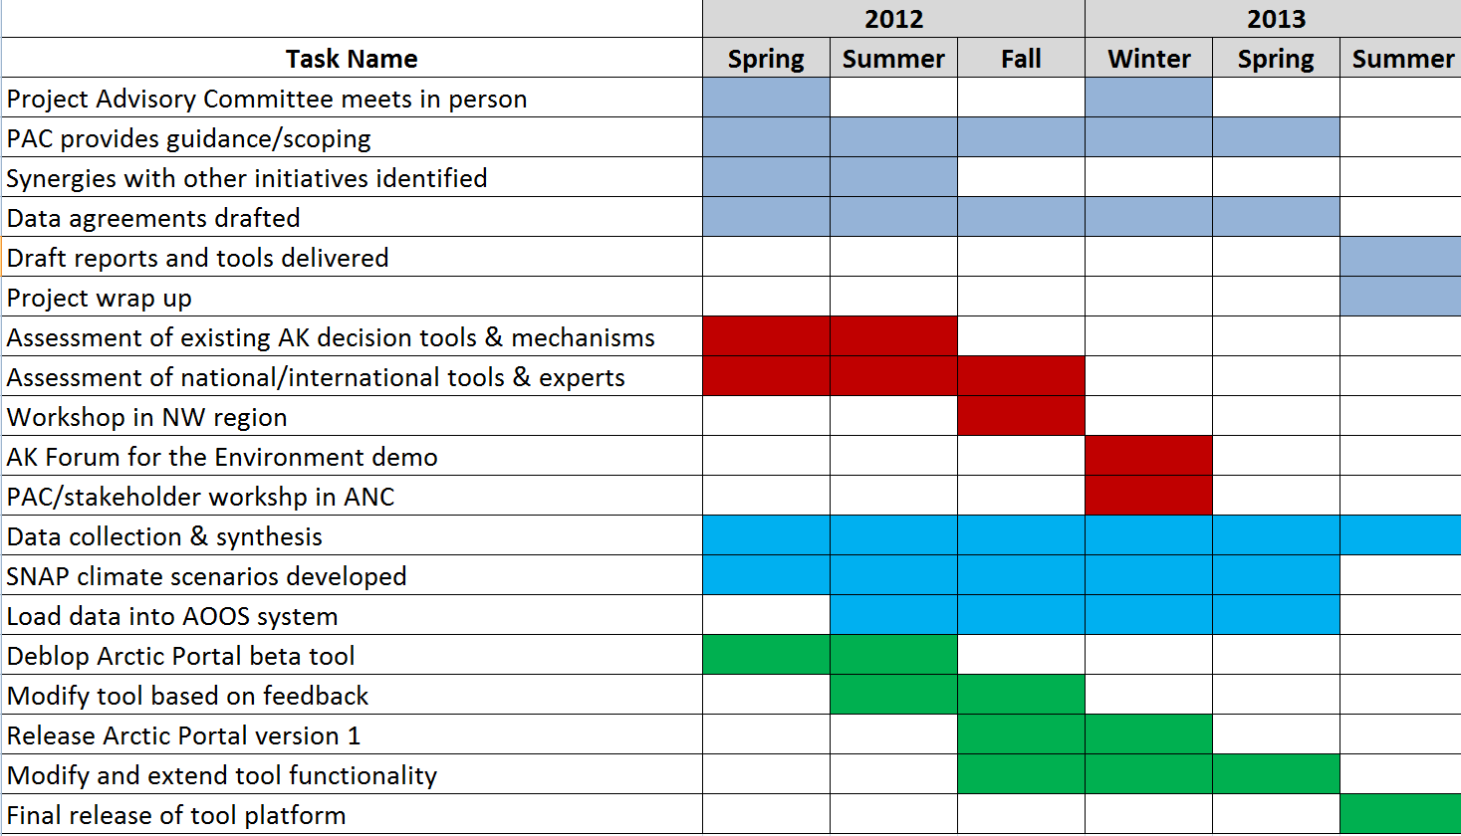
Project Timeline

