Slide 1
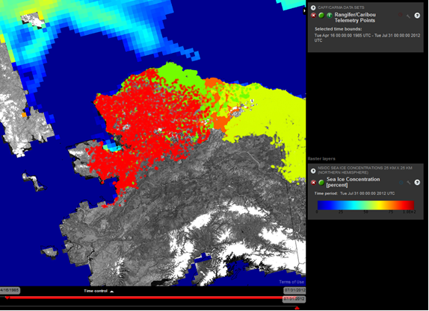
STAMP
Progress to Date
Spatial Tools for Arctic Mapping & Planning
Sept 24, 2012
Notes:
House-keeping items:
Bathrooms open
Lunch at noon
Hot water in kitchen
Breakfast tomorrow same as today.
Webinar for ACCAP in Fairbanks, and TNC in Seattle and Maine. We’ll try to make sure we give folks on phone chance to speak up.
Welcome some new people to the group – Paul Gill replaced Shane Montoya from USCG who changed roles. Chad Nordlund representing NWAB for Tom Okleasik. Rose Fosdick from Kawerek in Nome was unable to attend the April meeting. welcome to her. We’re missing Katie Howard from ADFG – she is in the field, and her colleagues were sent to other meetings. Will make sure to follow up with them afterward.
Introductions.

Slide 2
Quick Refresher
NOAA funding – Regional Ocean Partnership Program
$760K over 1.5 years (Jan 2012-June 2013)
Project partners:
AOOS/Axiom
UAF’s Alaska Center for Climate Assessment & Policy
UAA’s Institute for Social & Economic Research
The Nature Conservancy
Notes:
Quick refresher, particularly for new people.
Project partners are in the room, and will be leading various sessions over the next day and a half, providing updates on their work and seeking input.

Slide 3
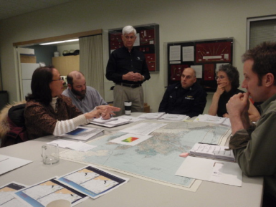
Goal
Create new data tools to improve access and usability
of Arctic data, and help inform conversations related to commercial fisheries decisions
Focus on tool development only, not actual fisheries decisions or management plan
Serve the needs of a broad audience:
Resource managers and planners (tribal, local, state, federal, industry, NGO)
Stakeholders who provide input into those decisions
People with interest in specific aspects of the Alaska marine environment, and who want to access data
Notes:
Decision of this focus was agreed upon by state of Alaska, NPFMC.
Realize this is not an imminent decision. Fisheries are closed, and its not clear they are economically feasible or environmentally sustainable.
What would we need to know? How can we best format the information we have to be usable and accessible? Better knowledge of available information.
The applicability does not stop with fisheries decisions.
Intention of the tool is to serve broader needs as well – address other issues, and also a spectrum of stakeholders.

Slide 4
Project Components
Scoping: interviews and online survey addressing user needs – what kind of tool capabilities would best meet peoples’ needs, and what data is highest priority?
Synergies: identify other programs and projects producing or aggregating data, or that could contribute to or benefit from STAMP; foster collaboration.
Documentation: document existing data products and decision support tools used in Alaska, and review new tools and their potential applicability to Alaska.
Tool Development: incorporate existing data layers into the AOOS Arctic Ocean Portal, and add new functional capabilities identified through the scoping efforts.
Assessment: review the AOOS Arctic Portal (enhanced with new datasets and capabilities), and determine whether it has successfully addressed user needs.
Notes:
Scoping: This was the TNC – led by Jessica Speed. Survey and interviews this summer. She’ll be describing methods and results. Survey was added after feedback from advisory group in April. Results are readjusting our focus. THANK YOU to advisory group members that participated in this process.
Synergies: Conversations with a number of groups and integrated research projects. Rob will be talking about some of these during the data discussion. Also given presentations. Have more work to do here.
Documentation: what methods are people using right now to make decisions about the marine environment…. This was part of survey/interviews which Jessica will cover. Also includes a review of tools being used elsewhere and how they might apply to Alaska. Zach Ferdana and Peter Taylor from the TNC are working on this presently. Will be getting some feedback from this group, and finishing their report on November.
Tool Development: Axiom has been working on this steadily through the summer. Has a new interface to demonstrate, as well as new data layers. Will be showing today. Getting feedback.
Assessment part will come this spring, with probably check-in with advisory group between now and then.

Slide 5
Outreach
Project website: http://www.aoos.org/stamp/
List serve for bi-monthly project updates (120+ people)
Presentations at Sharing Forums – (to date)
Kotzebue subsistence mapping workshop
Western AK Coastal Hazards Workshop
AK Climate Change Executive Roundtable
AOOS Board
Alaska Marine Policy Forum
Notes:
Doing our best to let people know about the project to create synergy.

Slide 6
On the horizon
North Pacific Fisheries Management Council (Oct 3)
Kotzebue Subsistence Mapping Workshop (Oct 24-25)
Barrow community presentation/meetings (Oct 31-Nov 2)
Alaska Forum for the Environment (Feb 2013)
Spring Workshop on decision support tools (Spring 2013)
Notes:
Spring workshop: advisory group + representative stakeholders
Share results of project, share case studies of decision support tools used by others outside AK, hear from experts in tool development, allow people to view and test the arctic portal. Feedback will help the project team think about next steps.

Slide 7
This Meeting
Reports from project partners
Are we on the right track
Going forward over the next 6 months
Notes:
Start off the morning with the TNC, results from scoping.
What we learned here was that the biggest need was to create a basic data access and viewing tool to provide a foundation rather than sophisticated analytics tools that we don’t have the data to populate. Modify our plan for the next two months. Jessica will describe; we can discuss whether we’re interpreting these results correctly.
Then move into data component – Rob will be giving an update on what data we’ve assimilated so far, demo the portal, talk about next steps.
Near the end of the day hear from ACCAP via webinar on climate downscaling… including some examples of how to use the results for decision making.
Start back up tomorrow at 9am with ISER
Leaves time tomorrow to talk about issues that may arise today, and also for some discussion on next steps after STAMP.
Adaptive agenda, allowing time for discussion.

