Slide 1
High-Frequency Radar Surface
Currents in Alaska: Bering Strait
Rachel Potter, Seth Danielson, Hank Statscewich
Thomas Weingartner (Emeritus)
May 11, 2018
AOOS Board Meting

Slide 2
High-Frequency Radar
Measures surface currents in real-time
Need two field sites minimum because each site
measures currents in only one-dimension
Coverage area depends on frequency
25 MHz
15 km site separation
500 m resolution
20 km offshore
(Not drawn to scale)

Slide 3
High-Frequency Radar
Measures surface currents in real-time
Need two field sites minimum because each site
measures currents in only one-dimension
Coverage area depends on frequency
12 MHz
30 km site separation
1 km resolution
50 km offshore
(Not drawn to scale)

Slide 4
High-Frequency Radar
Measures surface currents in real-time
Need two field sites minimum because each site
measures currents in only one-dimension
Coverage area depends on frequency
5 MHz
80 km site separation
6 km resolution
180 km offshore
(Not drawn to scale)

Slide 5
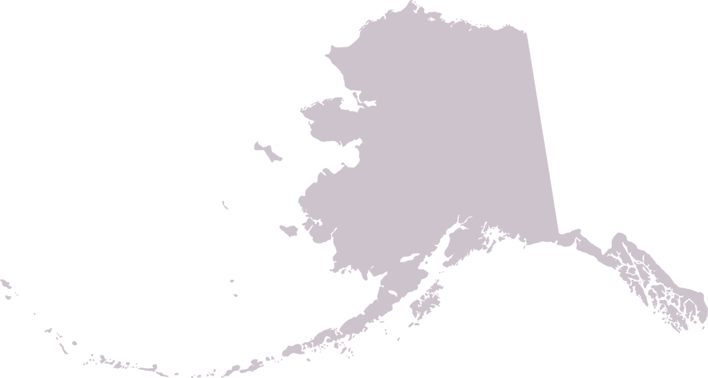
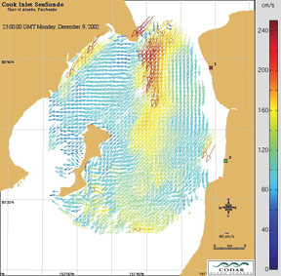
Past Alaska HFR Sites
Upper Cook Inlet
Funded by the Coastal Marine Institute - MMS
13 MHz System
Winter 2002 through Summer 2003
Revisited in 2009 when Redoubt erupted

Slide 6
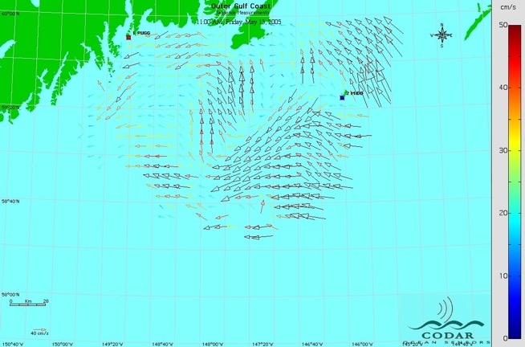
Past Alaska HFR Sites
Northern Gulf of Alaska
Rugged and Middleton Islands
Funded by NOAA-TWEAK
5 MHz System
Summer of 2004

Slide 7
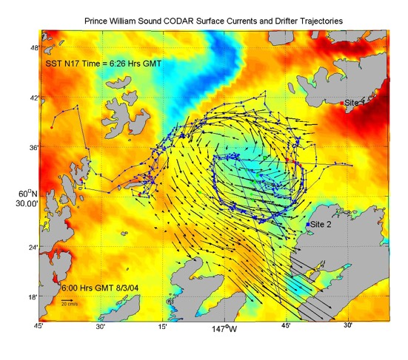
Past Alaska HFR Sites
Prince William Sound
Knowles Bay and Shelter Bay
Funded by NASA, NOAA, AOOS, PWSSC, OSRI
13 MHz Systems
May 2004 through August 2006
Circulation Experiment in 2009
Remotely Powered

Slide 8
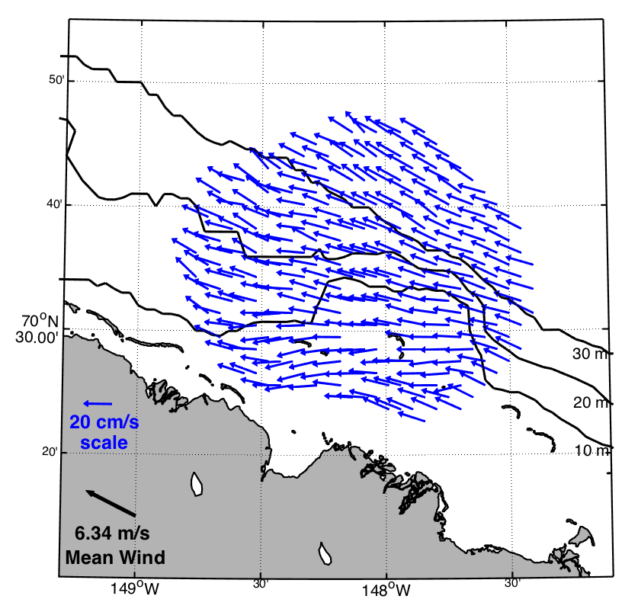
Past Alaska HFR Sites
Beaufort Sea, Prudhoe Bay
West Dock and Endicott
Funded by the Minerals Management Service
Switchable 13 and 25 MHz System
Openwater Seasons of 2005 and 2006

Slide 9
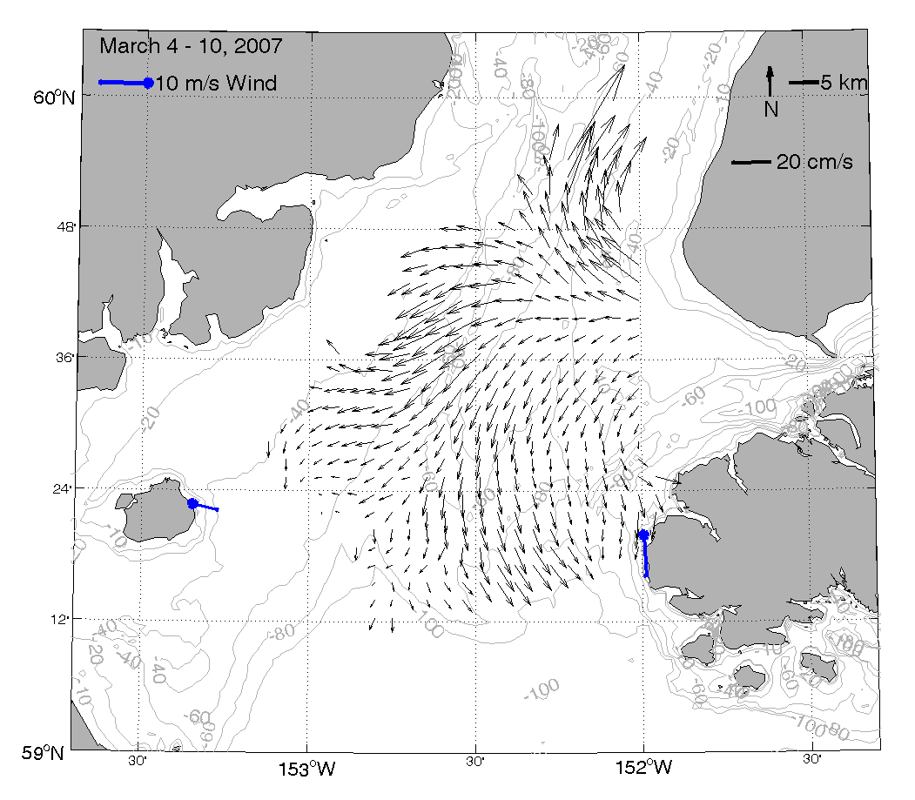
Past Alaska HFR Sites
Lower Cook Inlet
Anchor Point and Nanwalek
Funded by the Minerals Management Service
Switchable 13 and 25 MHz System
November 2006 – November 2007

Slide 10
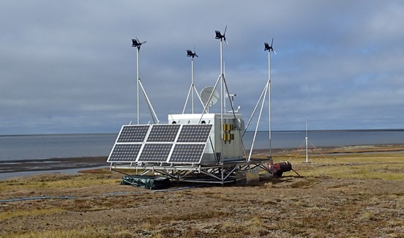
Past Alaska HFR Sites
Chukchi/Beaufort Sites
Point Lay, Icy Cape, Wainwright, Utqiagvik, Point Barrow, Cape Simpson
Funded by AOOS, Shell Oil, BOEM, NSB/Shell Baseline Studies Program, ConocoPhillips Alaska, Coastal Impact Assistance Program, and the National Center for Island, Maritime, and Extreme Environment Security
Mostly 5 MHz systems
Various configurations from September 2009 through the present
RPM at Icy Cape

Slide 11
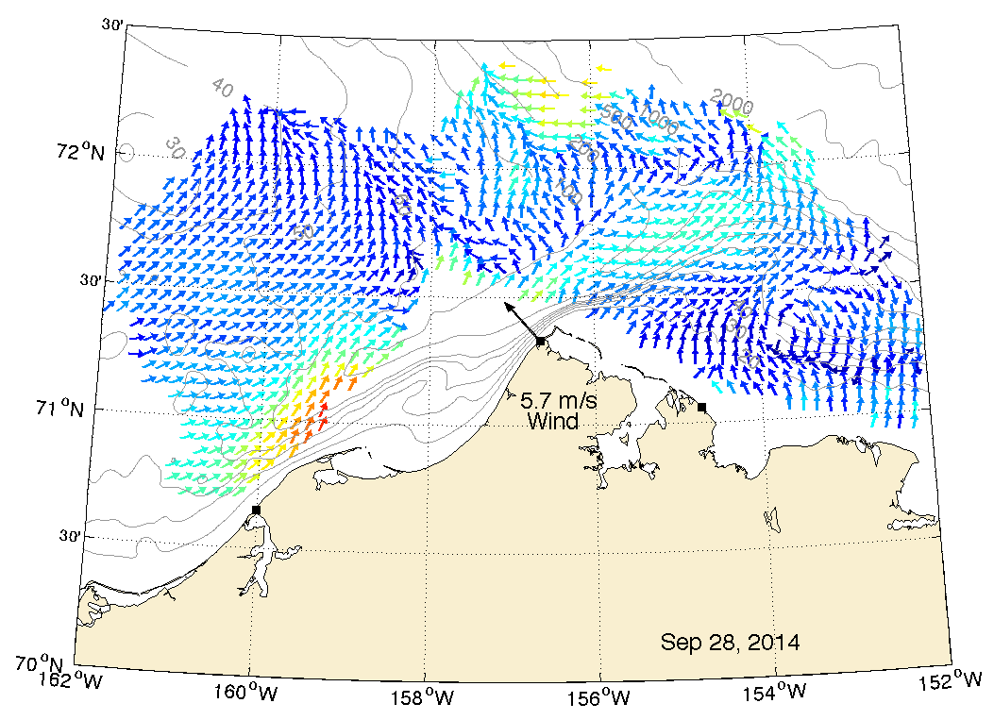
Present Alaska HFR Sites
Chukchi/Beaufort Sites
Wainwright, Point Barrow, Cape Simpson
Funded by AOOS
5 MHz systems
hourly
UAF
AOOS
hourly
hourly
IOOS National HFR Data Server

Slide 12
How is the data used nationally?
United States Coast Guard
SAROPS
National Weather Service
Weather and Marine Forecasts
NOAA Office of Response and Restoration
Oil/Contaminant Spill
National Data Buoy Center
Provides Additional Data Access

Slide 13
Future Alaska HFR Sites?
Chukchi/Beaufort Sites
Wainwright, Point Barrow, Cape Simpson
Funded by AOOS
5 MHz systems
Bering Strait
5 MHz systems

Slide 14
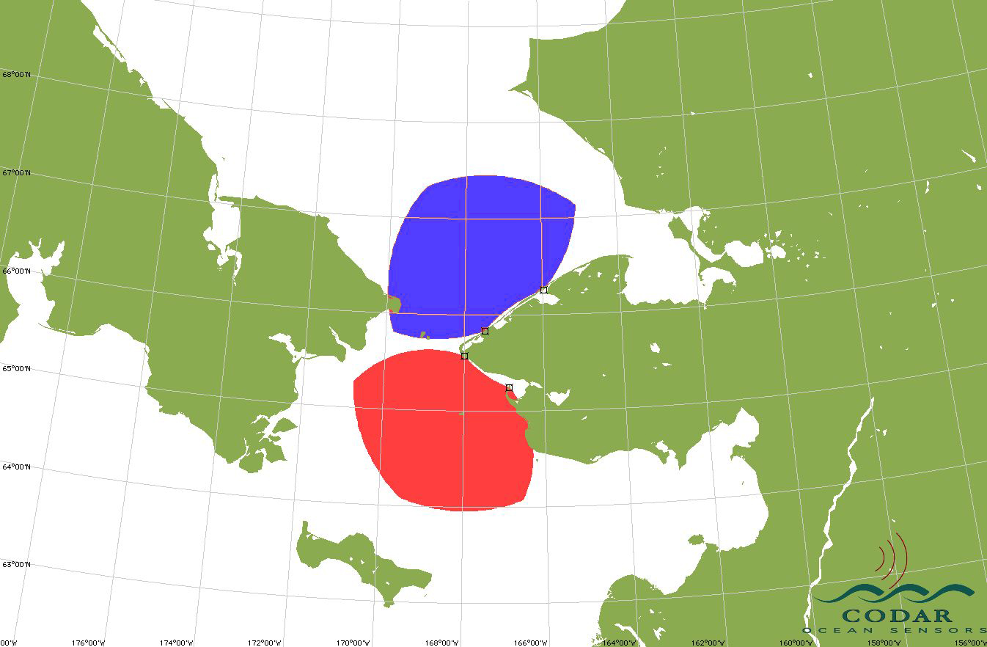
Bering Strait Coverage: 2 options
For both options…one grid powered site, one remotely powered

Slide 15
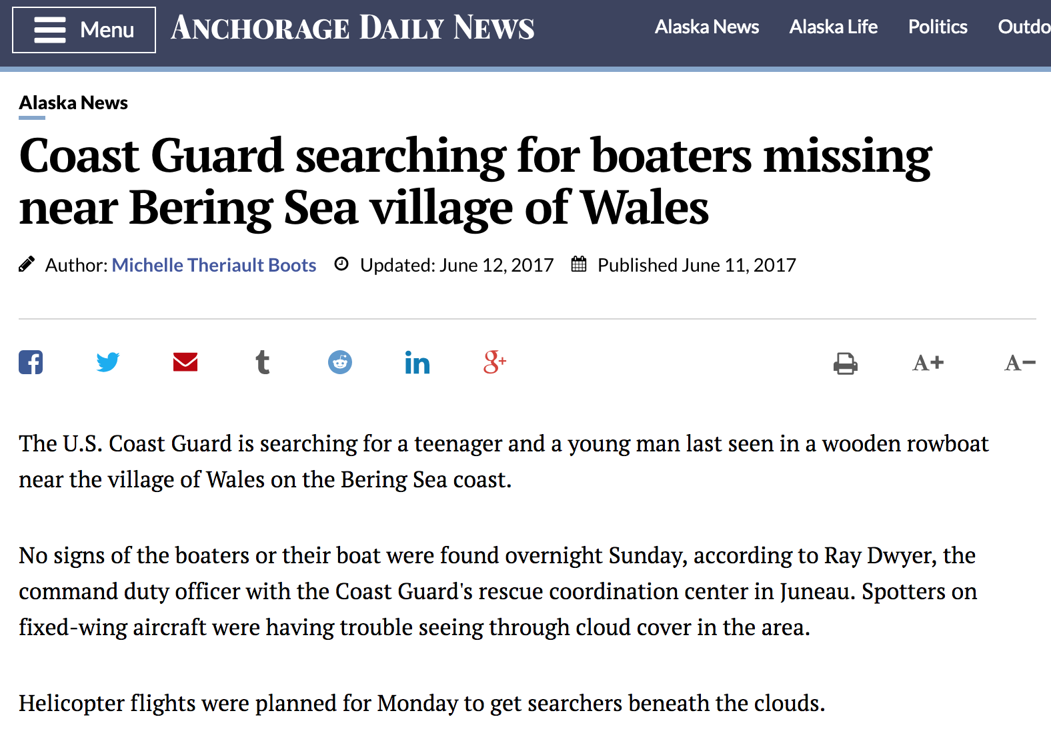
Bering Strait data usage?
Search and Rescue

Slide 16
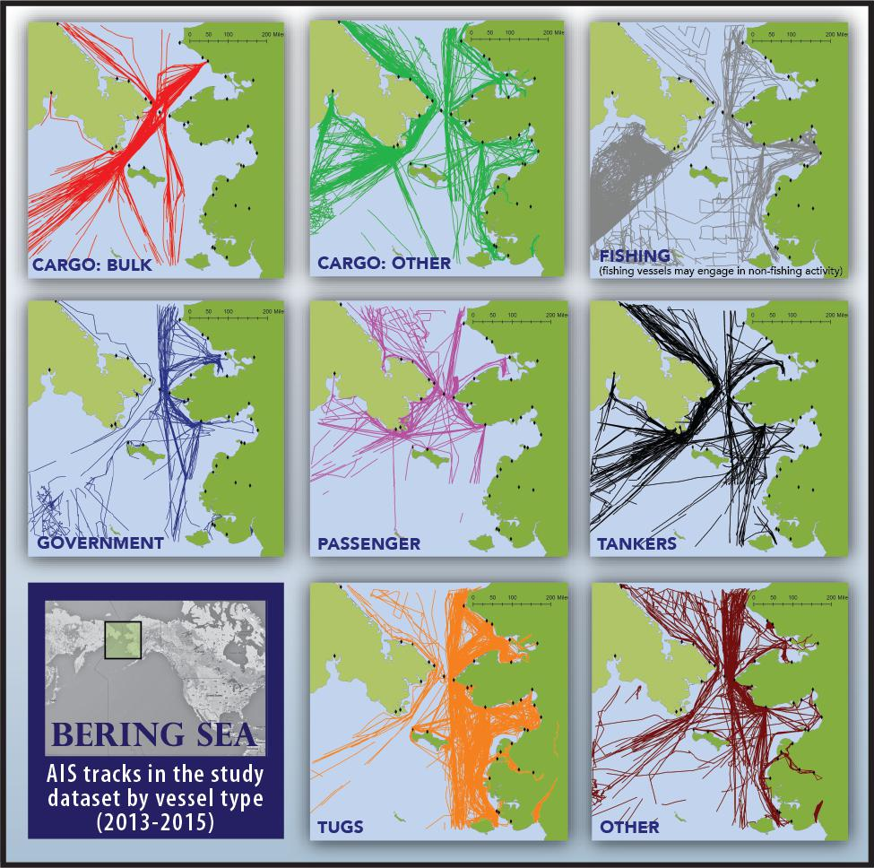
Bering Strait data usage?
Marine Traffic/Navigation
From:
Bering Sea Vessel Risk
Analysis,
Ocean Conservancy,
December 2016

Slide 17
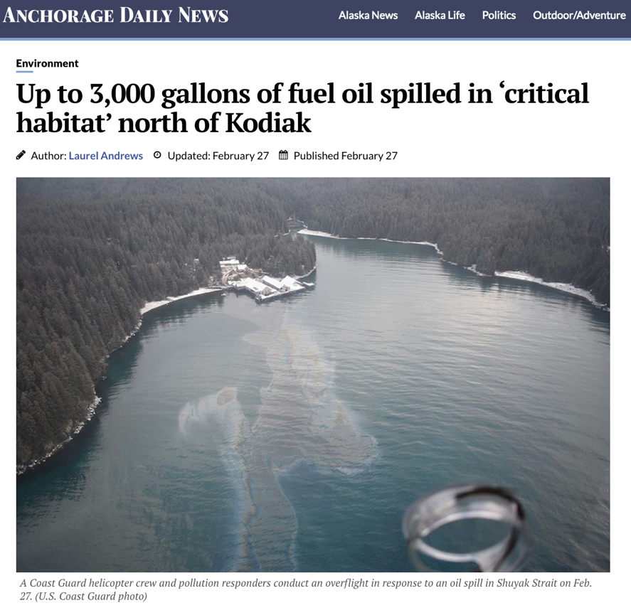
Bering Strait data usage?
Oil/Contaminant Spill

Slide 18
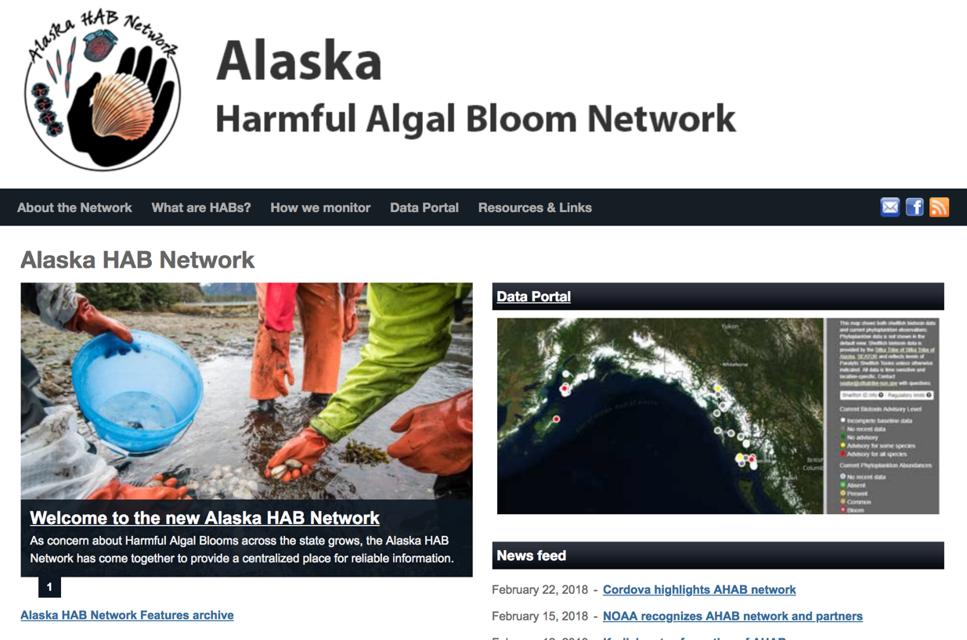
Bering Strait data usage?
Harmful Algal Blooms

Slide 19
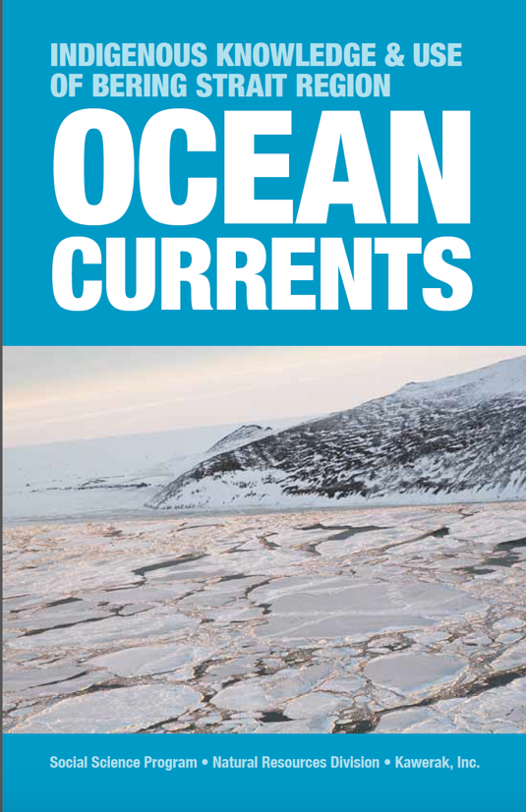
Bering Strait data usage?
Compliment Local Knowledge
Kawerak Publication
Compilation and Mapping of Village Expert Knowledge on Regional Ocean Circulation

Slide 20
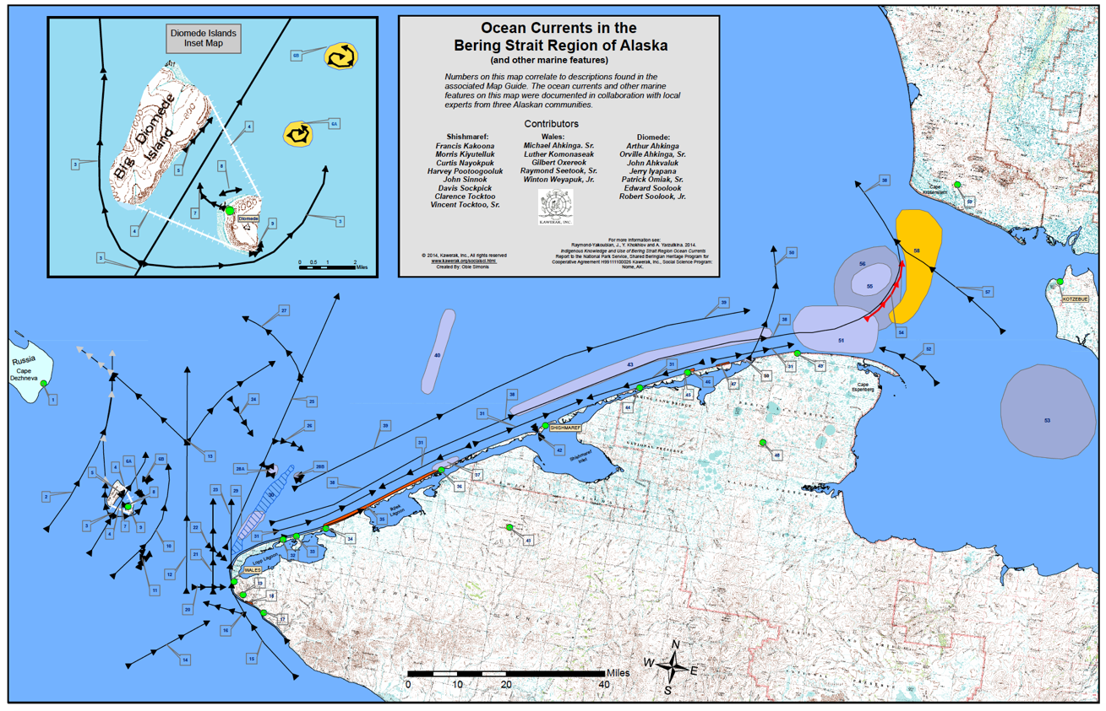
Bering Strait data usage?
Compliment Local Knowledge

Slide 21
Bering Strait data usage?
National Park Service – Scientific
Connection between lagoons in the Bering Land Bridge National Preserve and offshore waters

Slide 22
Thank you for your time!
Any questions? Discussion?
Rachel Potter
rapotter@alaska.edu

